Slide 1

ICU NURSE CALL SYSTEM
Real-time patient call prioritization using logic gates

Slide 2


PRESENTED BY:
LAIBA ALTAF (62431)
HOORIYA NOOR (64048)
ANMOL FATIMA (64316)

Slide 3
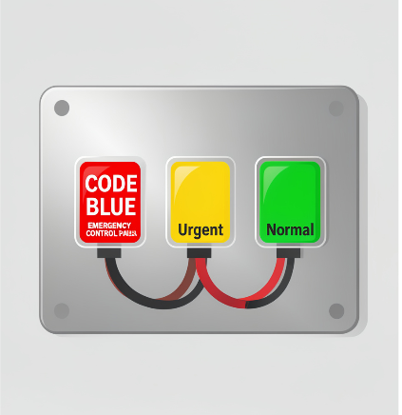
Introduction
Priority logic addresses patient calls with varying urgency to prevent
delayed responses.
Designed to classify calls as Code Blue, Urgent, or Normal and trigger immediate hardware indicators for high-priority events.

Slide 4

Scenario Explanation:
In an Intensive Care Unit (ICU), timely response to patient calls is critical for patient
safety and care quality. To efficiently manage and prioritize these calls, a logic
circuit-based system can be implemented.
This system uses logic gates to process three types of patient call signals:
Normal
Urgent
Code Blue.
The circuit assigns priority levels to each call type—Code Blue being the highest priority, followed by Urgent, then Normal. Based on these inputs, the system controls visual indicators (lights) and auditory alerts (buzzers/ speaker) to notify the medical staff of the most critical situation requiring immediate attention.

Slide 5
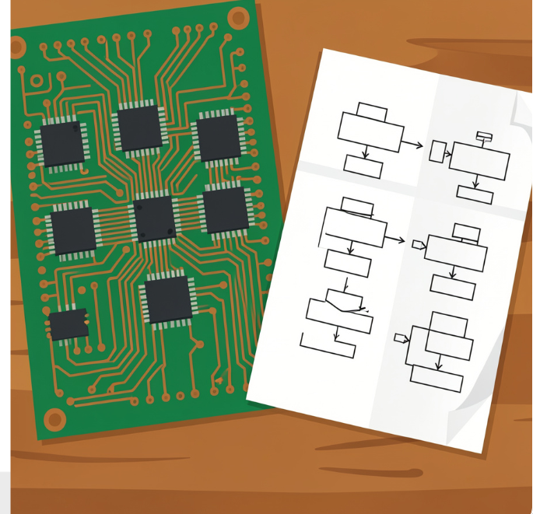
System Overview

Slide 6

Components Used:
Logic Gates:
AND gates
NOT gates
Visual Indicators:
Normal Call Light
Urgent Call Light
Code Blue Light
Auditory Indicators:
Normal Buzzer
Connecting Wires:
To connect components and inputs/outputs
Optional Components:
Resistors

Slide 7
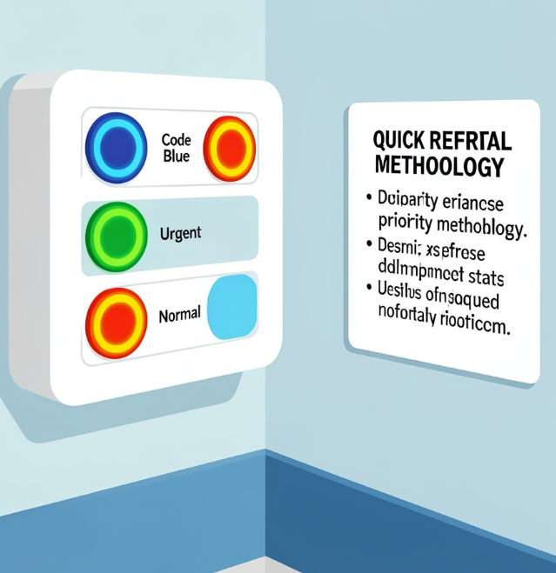
Processing Logic
Combinational logic implements hierarchy:
NOT blocks, AND conditions and finalizer so Code Blue
overrides all
Urgent acts only if Code Blue is inactive
Normal is lowest priority.

Slide 8
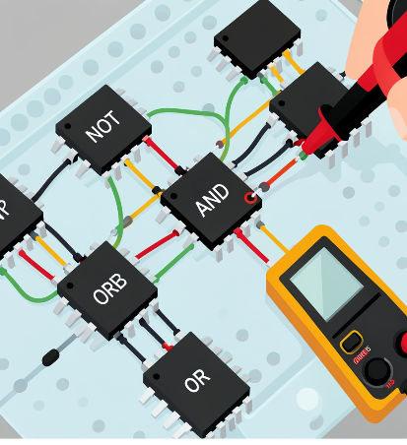
Outputs and Indicators
Outputs: LEDs and buzzers mapped to distinct priority states to ensure clear, immediate alerts.
The indicator mapping assigns Code Blue to the highest-priority alarm
Urgent to conditional alerts, and Normal to a low-priority signal for minimal disruption

Slide 9
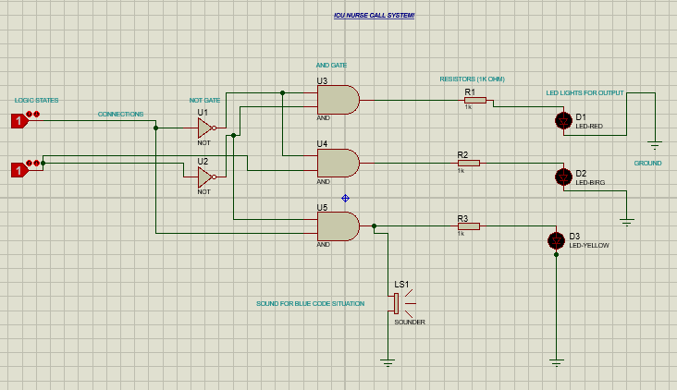
WORKING OF THE SYSTEM:
For A => 0, B => 0, the system generates an urgent condition output. This state activates the urgent indicator (red/emergency signal).
For A => 0, B => 1, the system represents a normal condition, activating the green LED to indicate a stable patient state.
For A => 1, B => 0, the system enters the most critical emergency state (blue code). This triggers the yellow LED along with the speaker/buzzer, indicating highest priority alert.
For A => 1, B => 1, the system remains in a dead/no-signal state, where no indicators are activated.
This design ensures clear, mutually exclusive prioritization of medical conditions for unambiguous response.

Slide 10
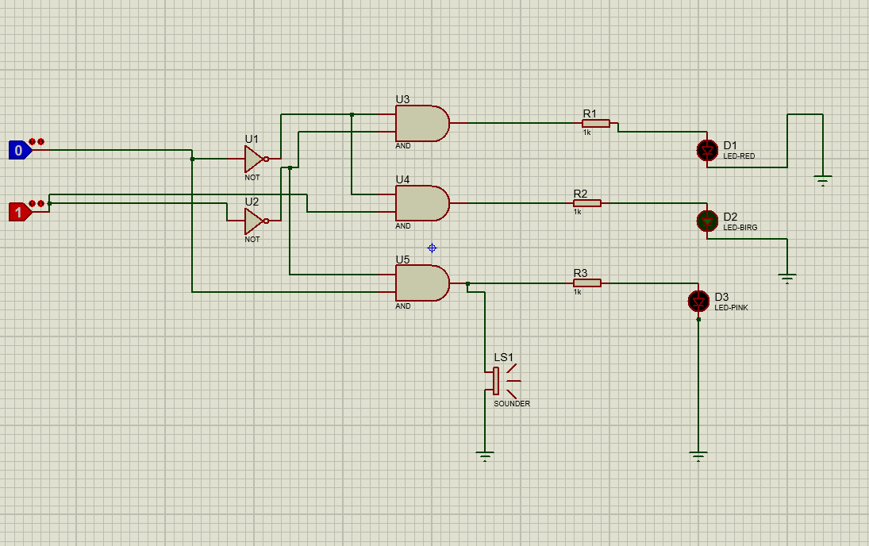
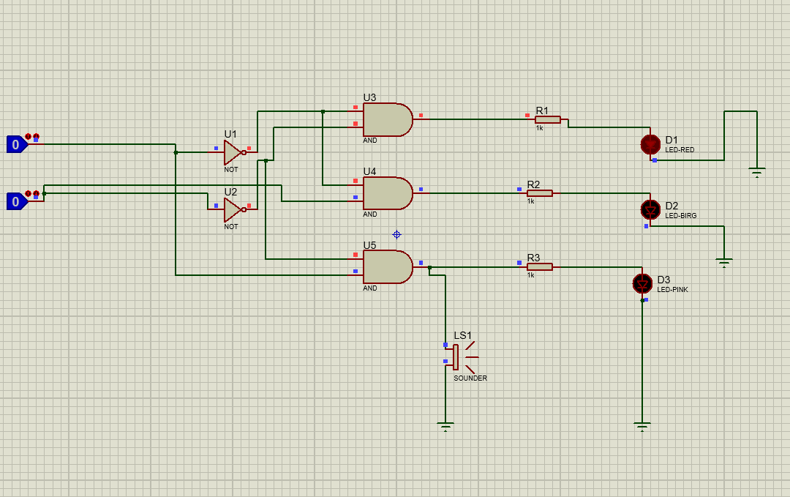
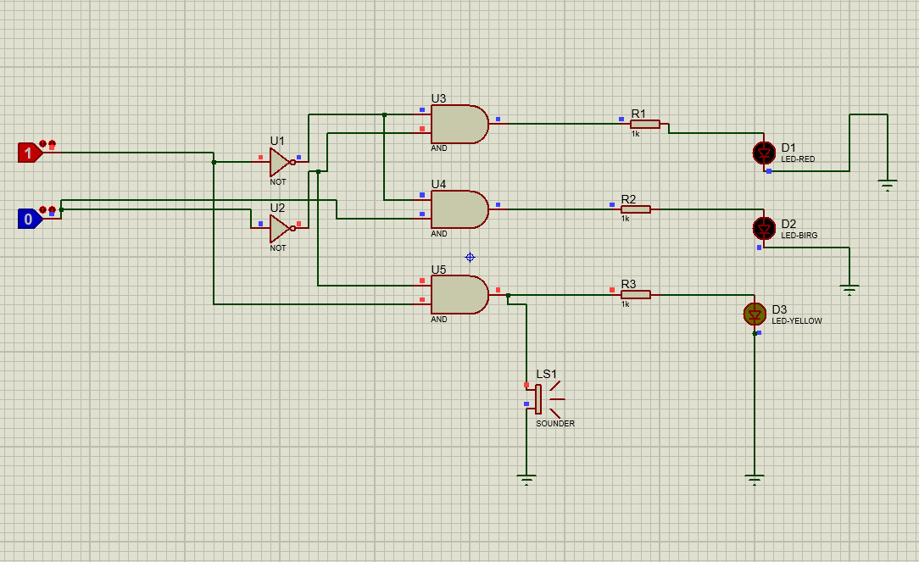

Slide 11
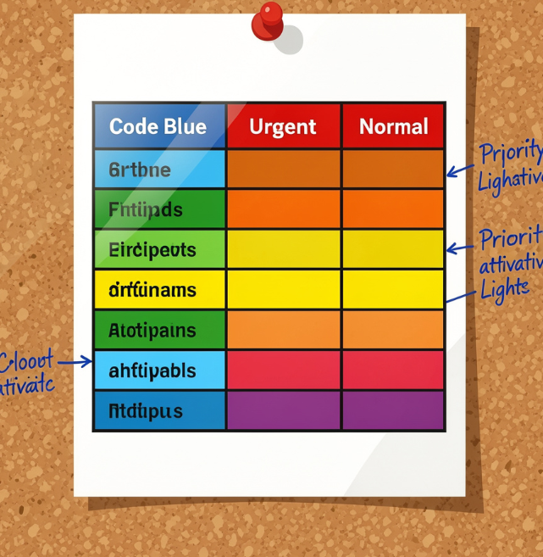
Truth Table Logic
A | B | Condition | Output Indicator
0 | 0 | Urgent | Red / Emergency
0 | 1 | Normal | Green LED
1 | 0 | Most Urgent (Blue Code) | Yellow LED + Speaker / Buzzer
1 | 1 | Dead / No Signal | No Output

Slide 12
Comparison with Microcontroller-Based Systems
Feature | Gate-Based System | Microcontroller-Based System
Response Time | Instant (hardware-level) | Slight processing delay
Flexibility | Fixed logic | Highly programmable
Complexity | Increases with scale | Managed via software
Cost | Low for small systems | Higher initial cost
Scalability | Limited | Highly scalable

Slide 13

Advantages of the Logic Gate-Based System:
1. Simplicity and Reliability:
The gate-based system is straightforward, with fewer components compared to microcontroller-based systems, leading to increased reliability and easier troubleshooting.
2. Cost-Effective Implementation:
Using basic logic gates reduces overall costs, making it accessible for various hospital setups without significant investment in advanced electronics.
3. Fast Response Time:
Pure hardware logic ensures rapid decision-making, essential in critical situations like Code Blue, where every second counts.
4. Ease of Integration:
The circuit can be integrated into existing hospital alarm systems with minimal modifications, enhancing overall workflow.

Slide 14

Conclusions
The system successfully implements hierarchical prioritization with basic logic gates, delivering reliable, instant responses.
This simple, deterministic design provides a robust foundation for scaling toward
more advanced medical notification systems.

Slide 15

Future Enhancement
Using this ICU Nurse Call Priority System model as a foundation, you can implement several future enhancements to improve functionality, efficiency, and user experience.
Here are some ways to do that:
Future Enhancements for the ICU Nurse Call Priority SystemWireless
Communication Integration:
Incorporate wireless modules (e.g., Wi-Fi, Bluetooth, Zigbee) to eliminate
wiring and enable remote alerts to nurses' mobile devices or central
monitoring stations.
Digital Display and Interface:
Add LCD or LED displays to show real-time patient status, priority level,
or room number, improving clarity and quick response.
Emergency and Backup Systems:
Incorporate backup power supplies (UPS) to maintain operation during
power outages.

